Slide 1

Virtual Reality and
Brain Computer Interface In Games

Slide 2
PAGE 1
Peripheral
Peripheral
PAGE 2
Peripheral
PAGE 3
PAGE 4
Peripheral
PAGE 5
Peripheral

Slide 3
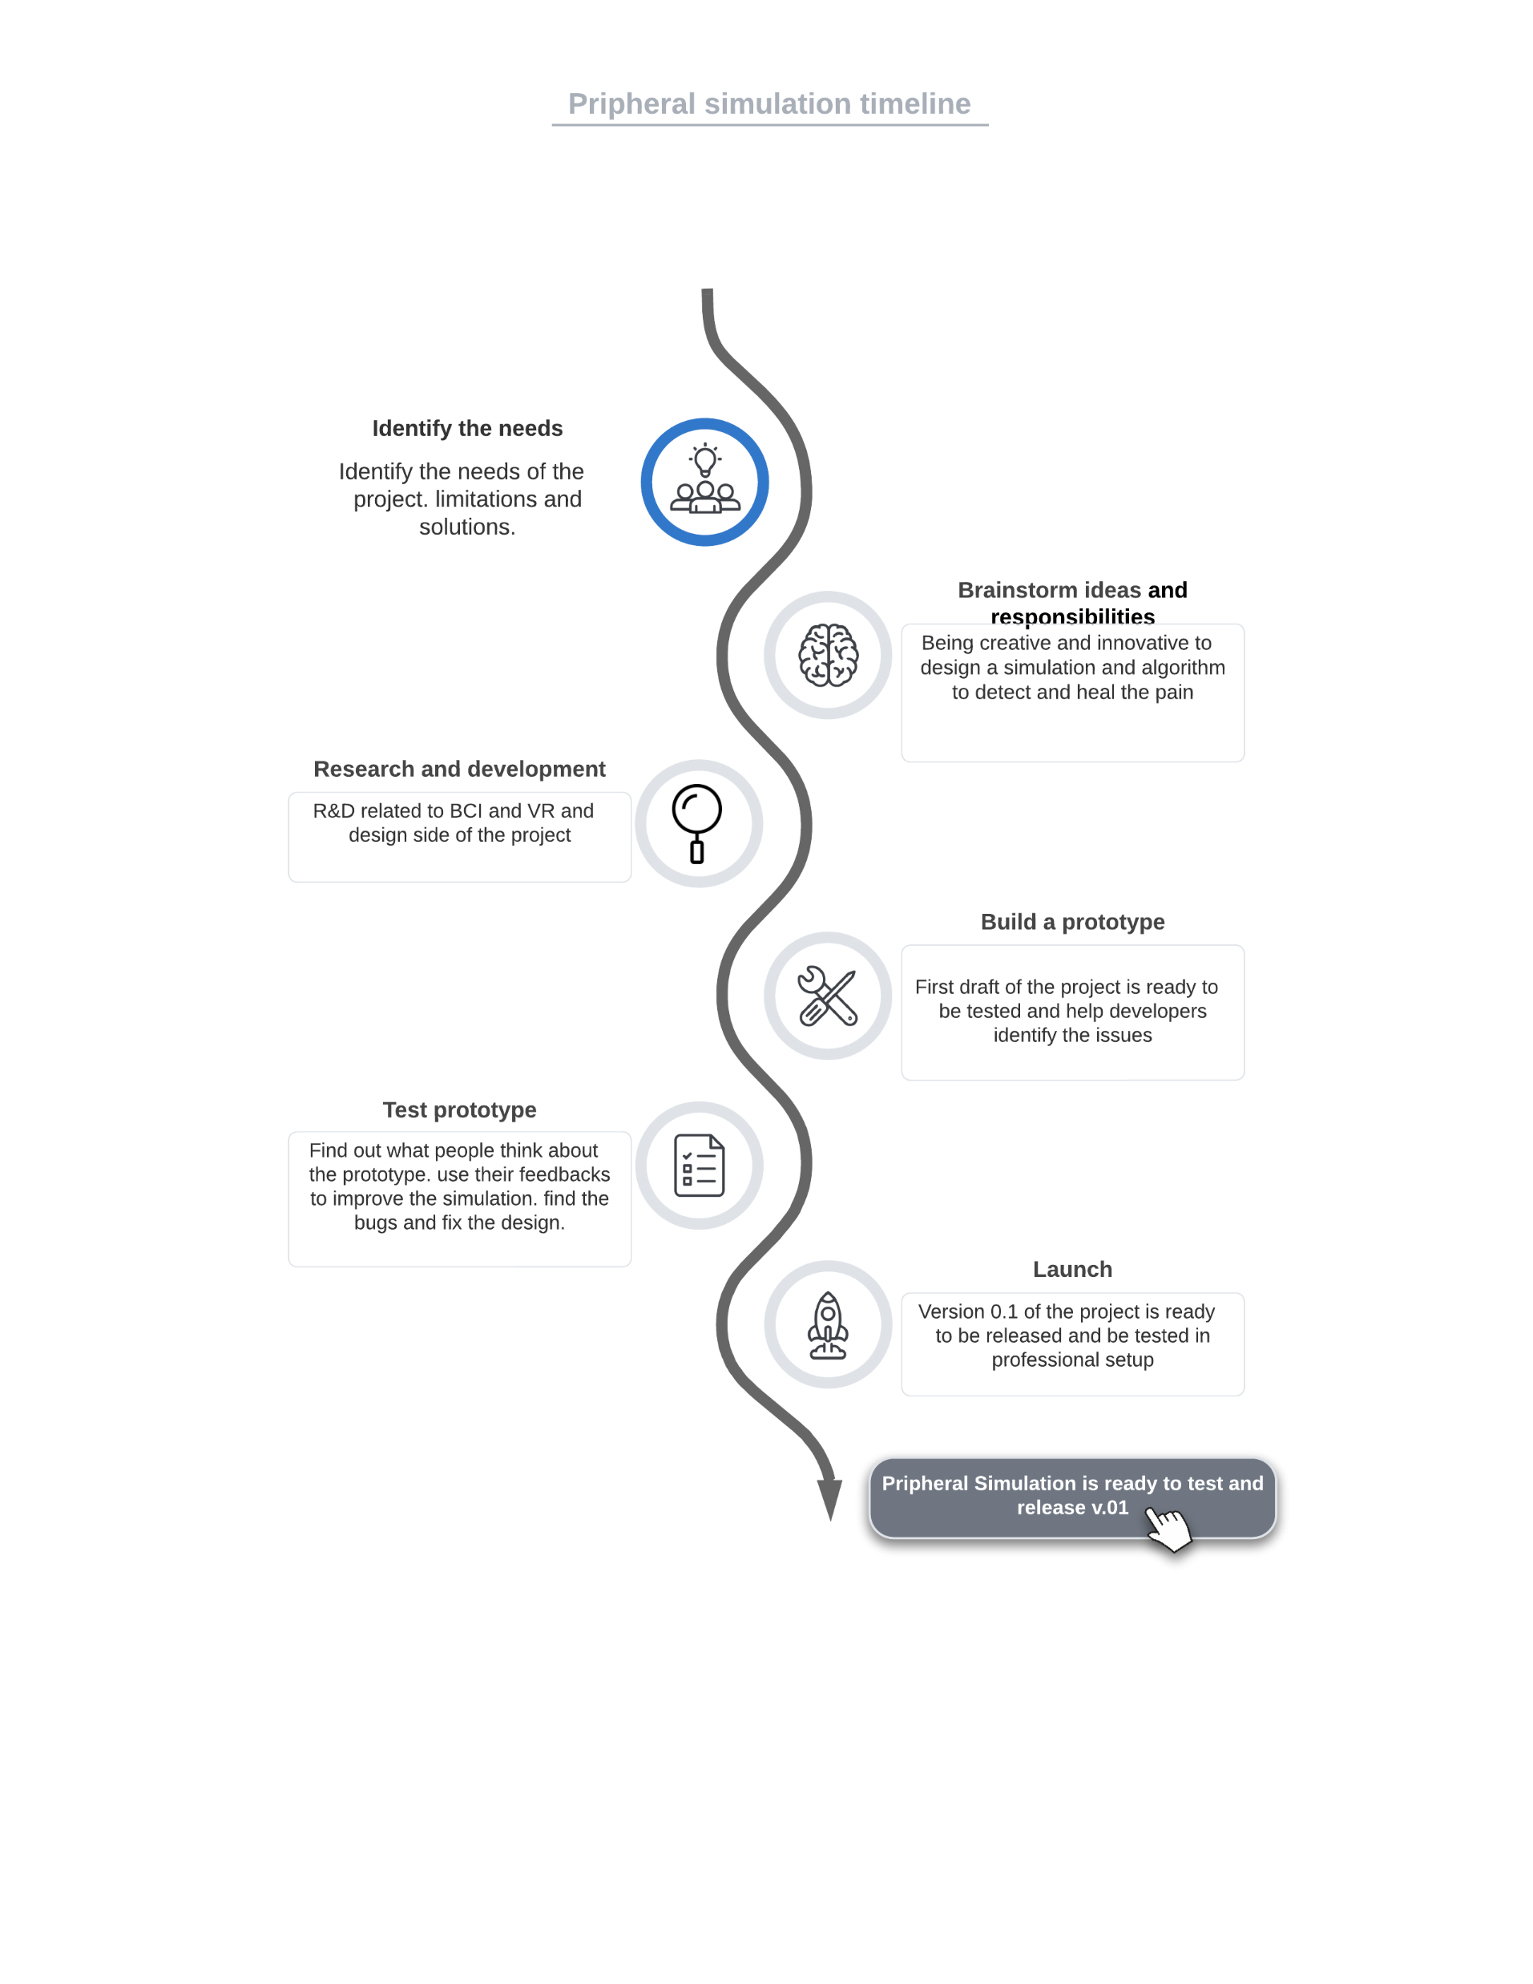

Slide 4
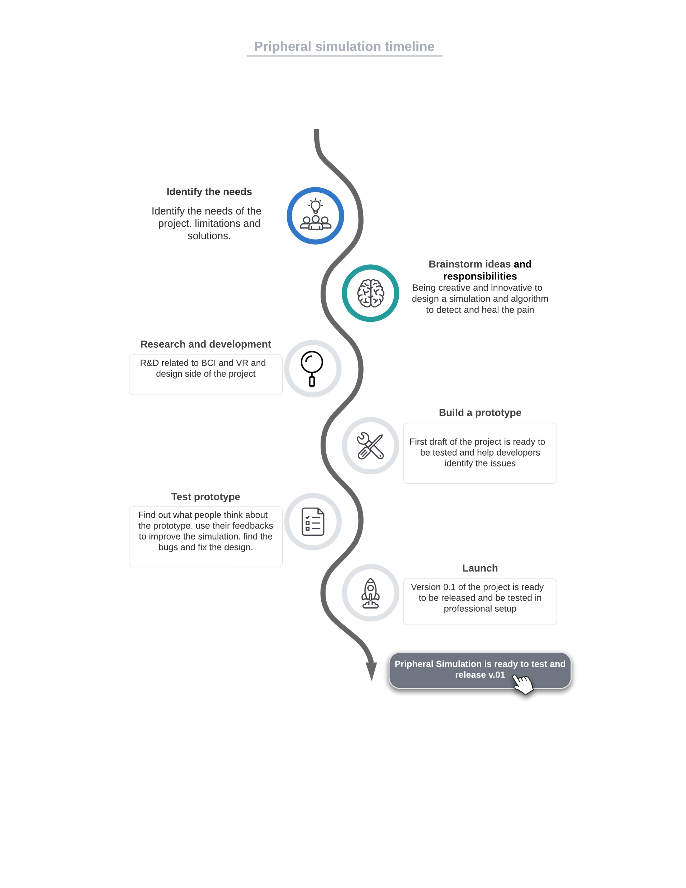

Slide 5
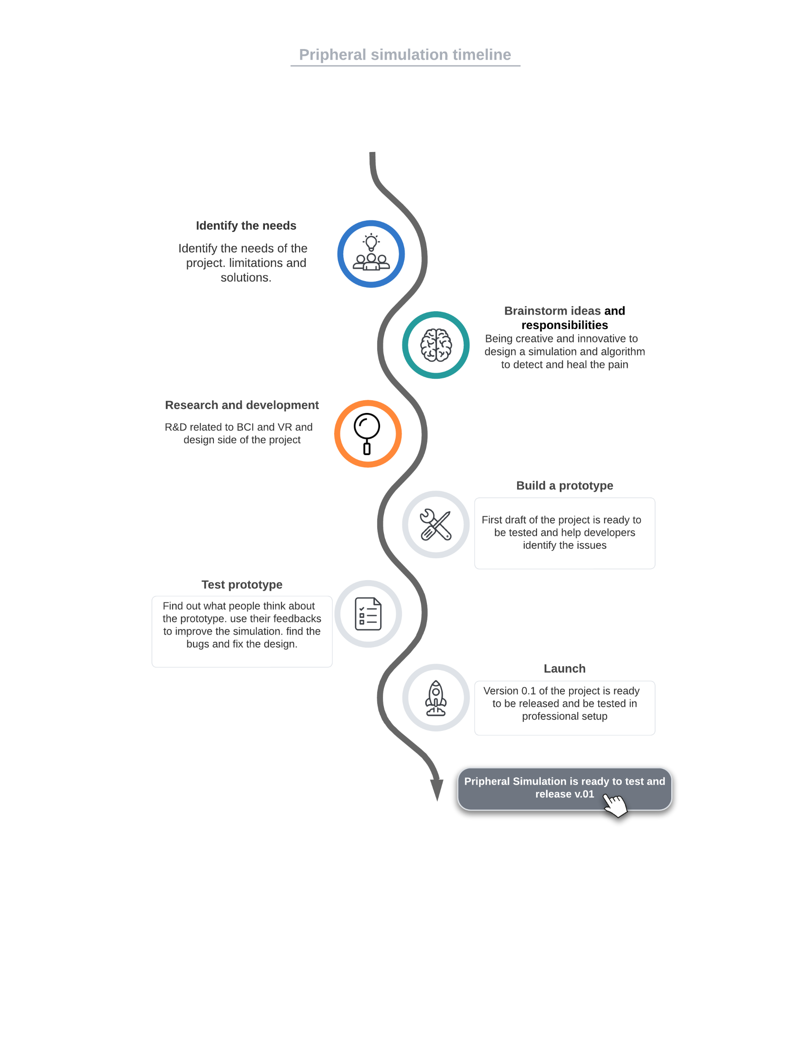

Slide 6
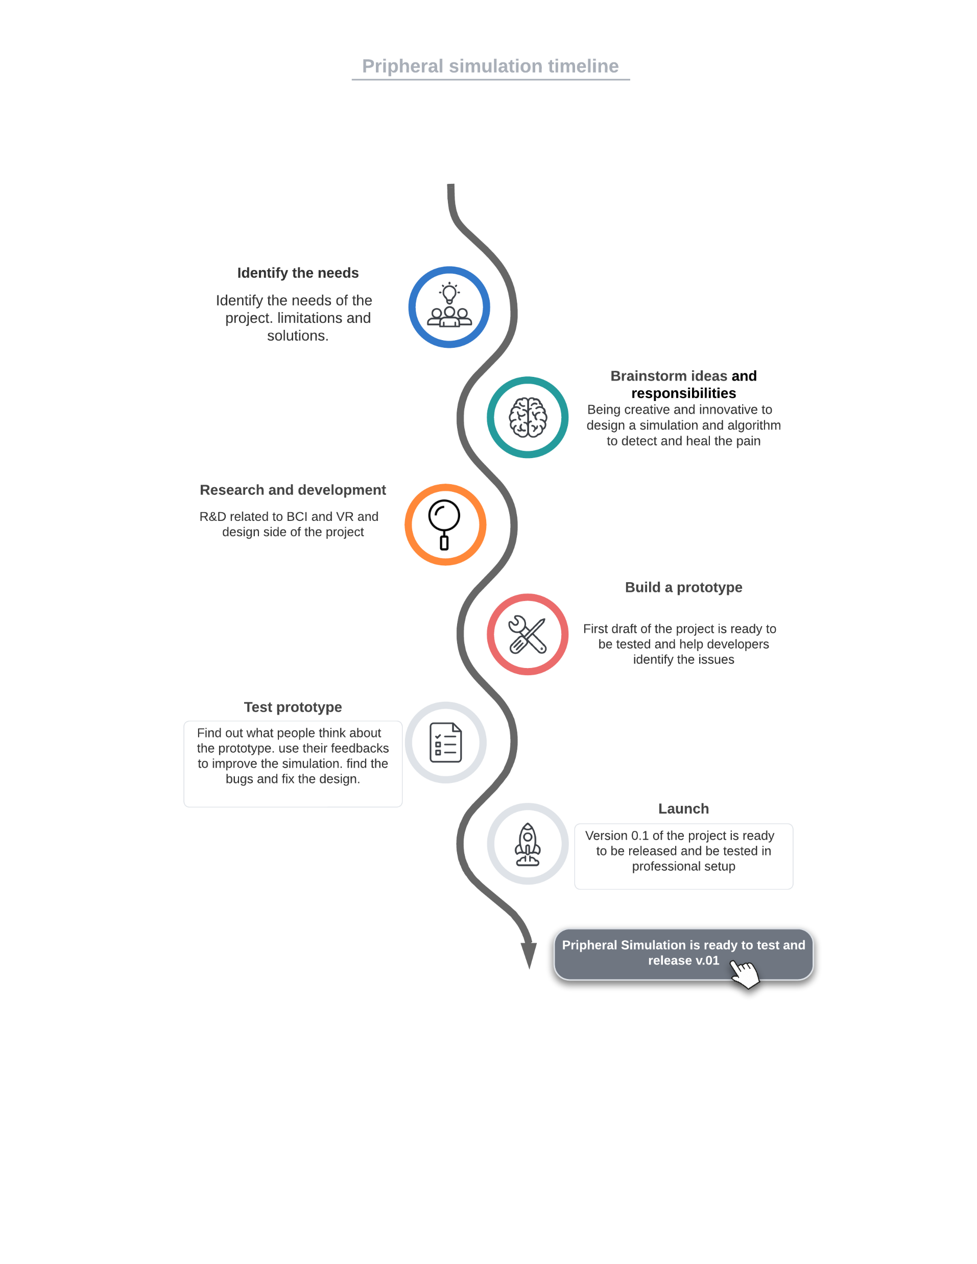

Slide 7
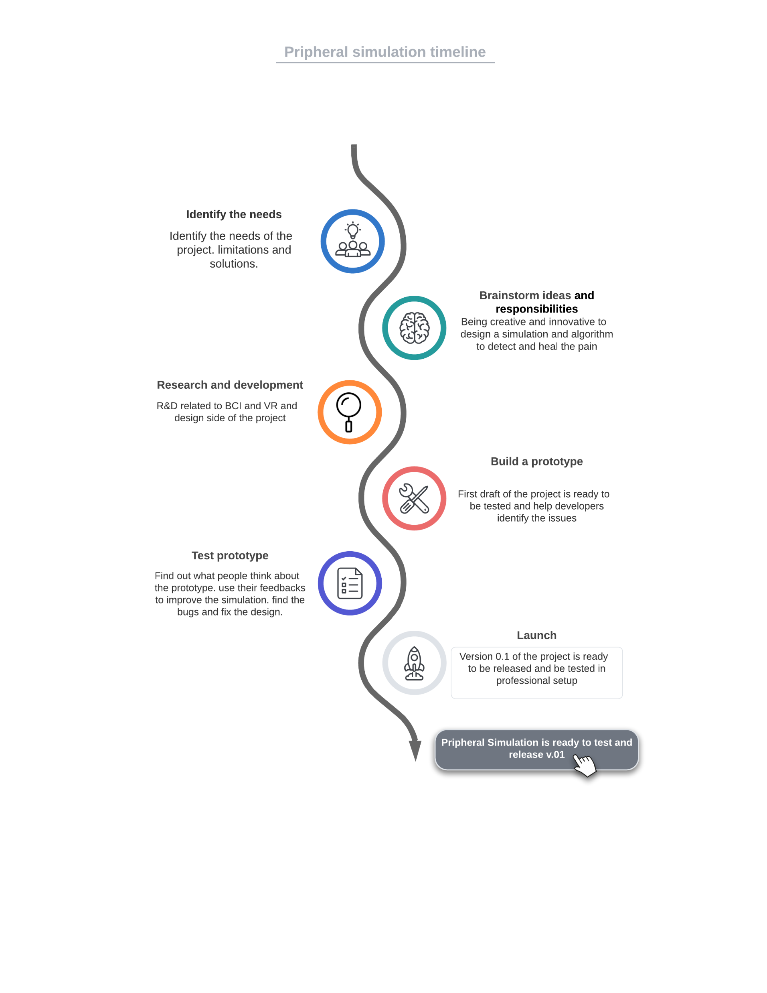

Slide 8
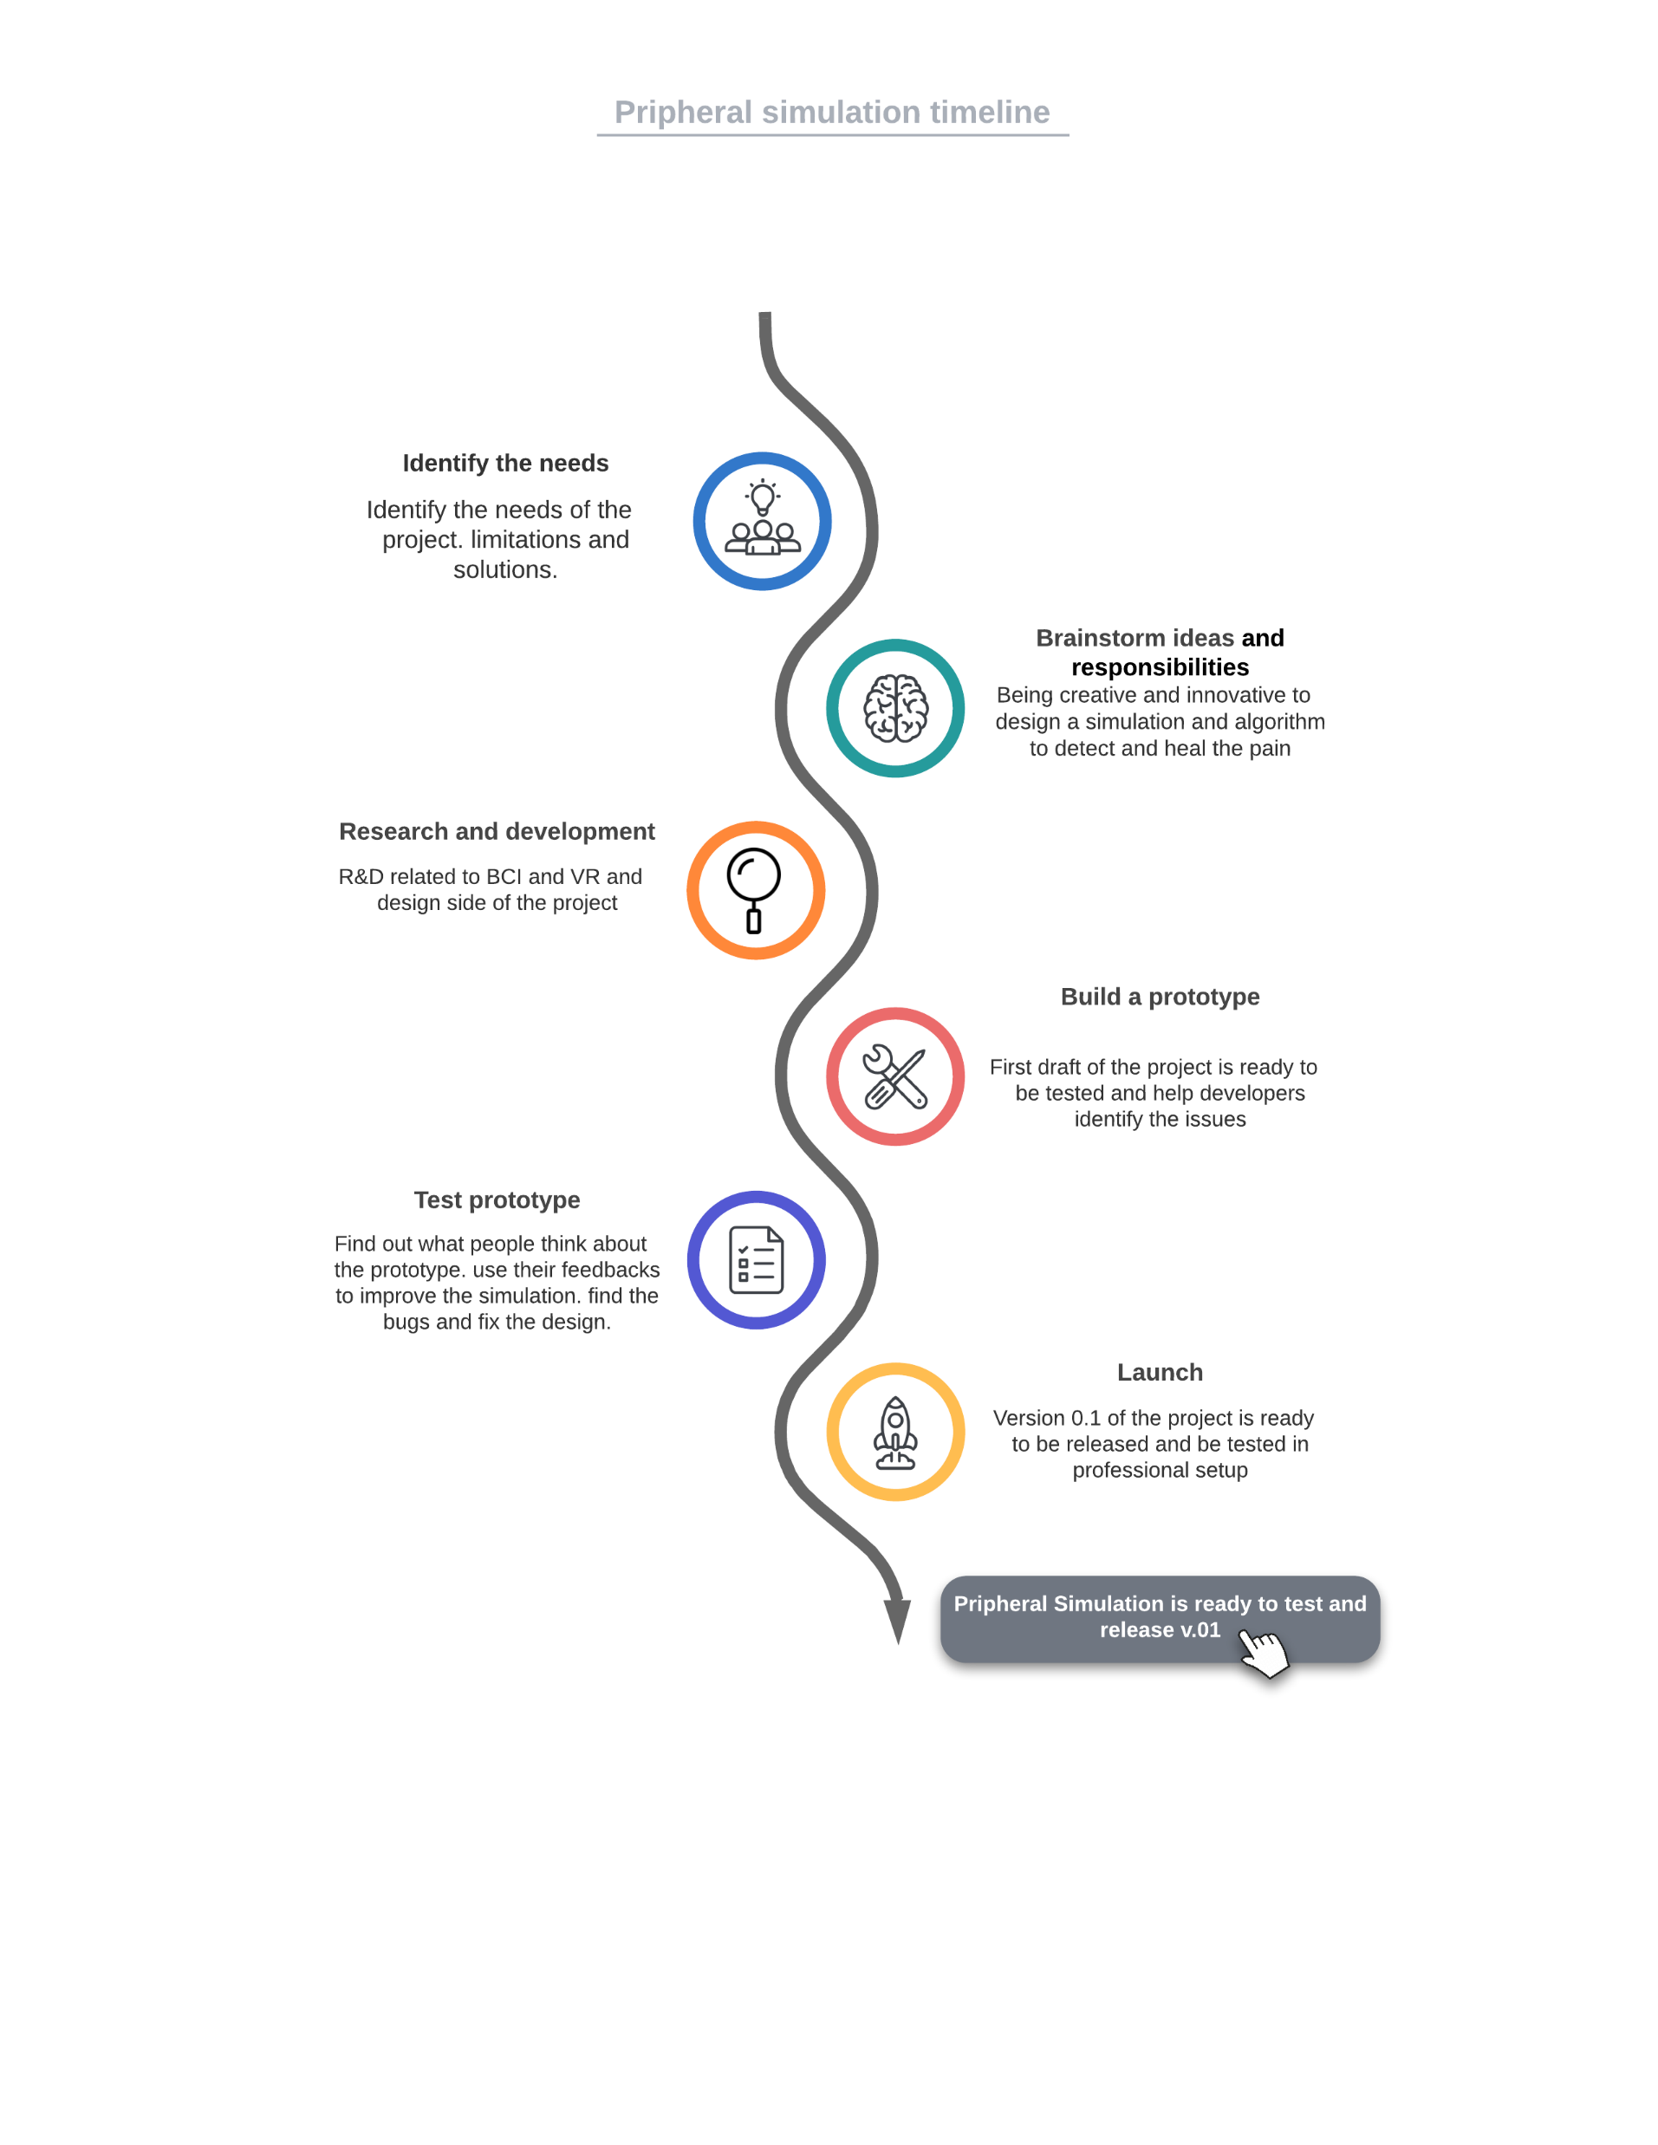

Slide 9
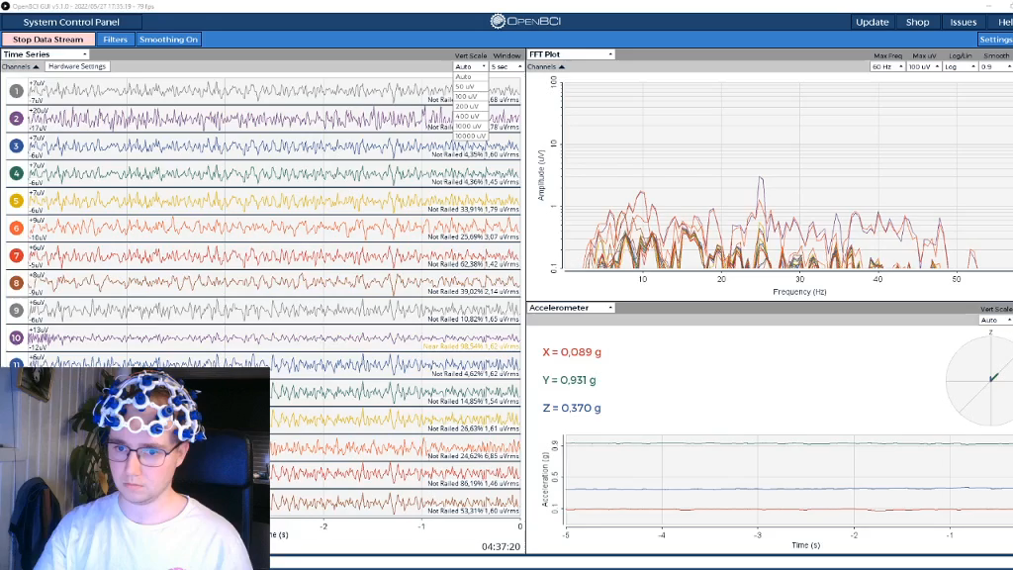
Virtual Reality and
Brain Computer Interface In Games

Slide 10
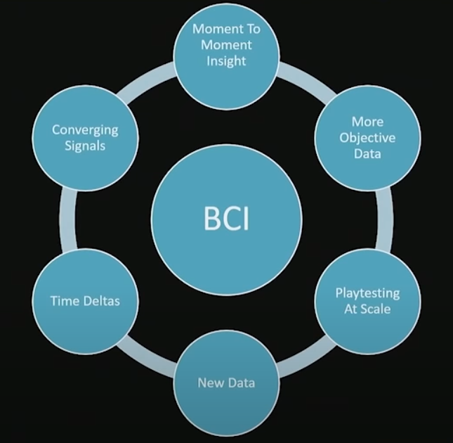
Virtual Reality and
Brain Computer Interface In Games

Slide 11
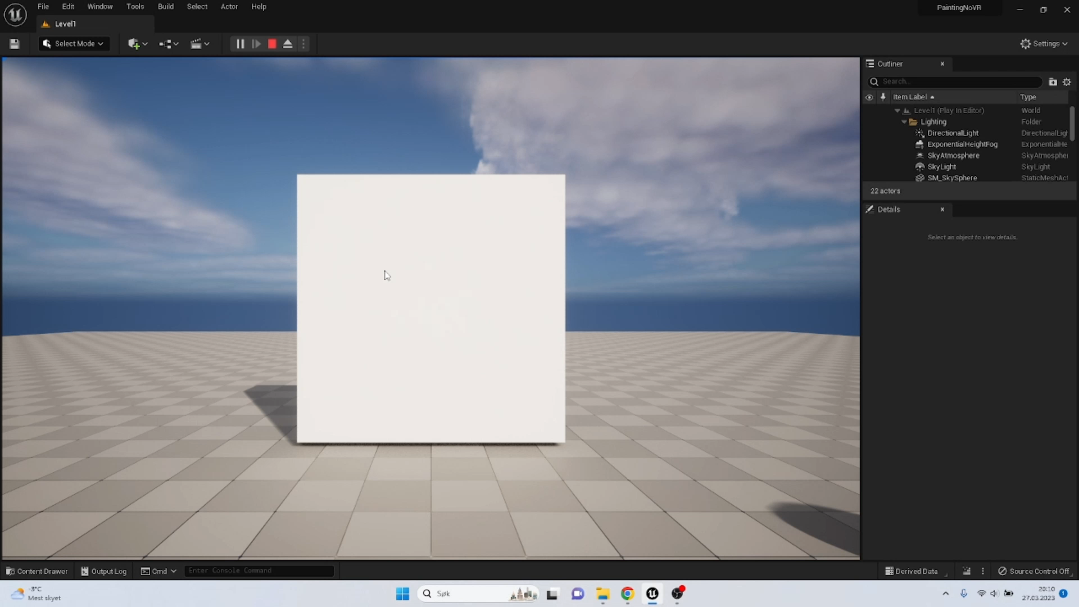
Virtual Reality and
Brain Computer Interface In Games

Slide 12
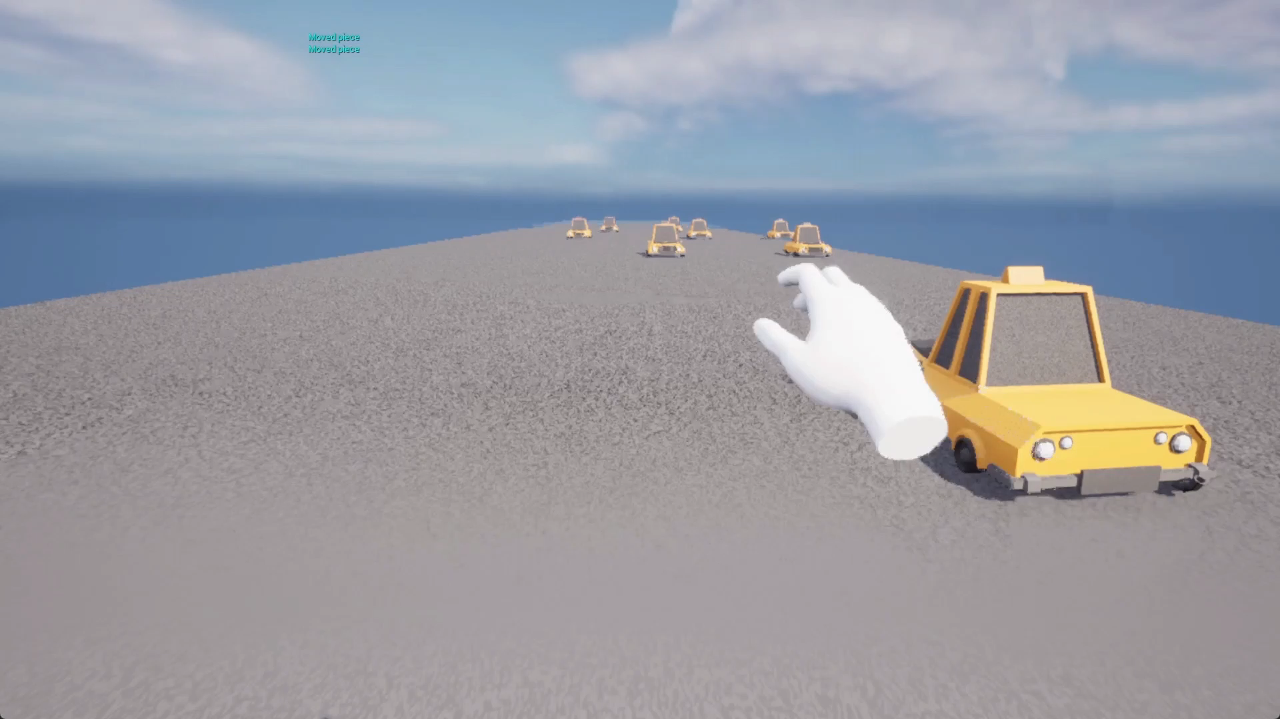
Virtual Reality and
Brain Computer Interface In Games

Slide 13
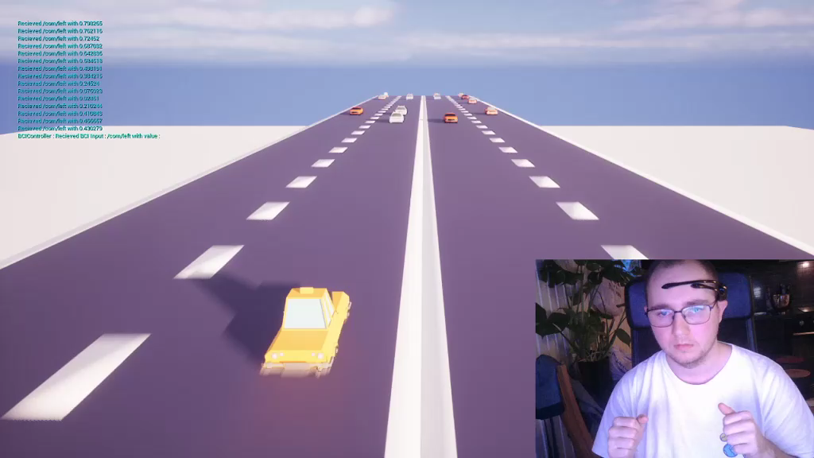
Virtual Reality and
Brain Computer Interface In Games

Slide 14
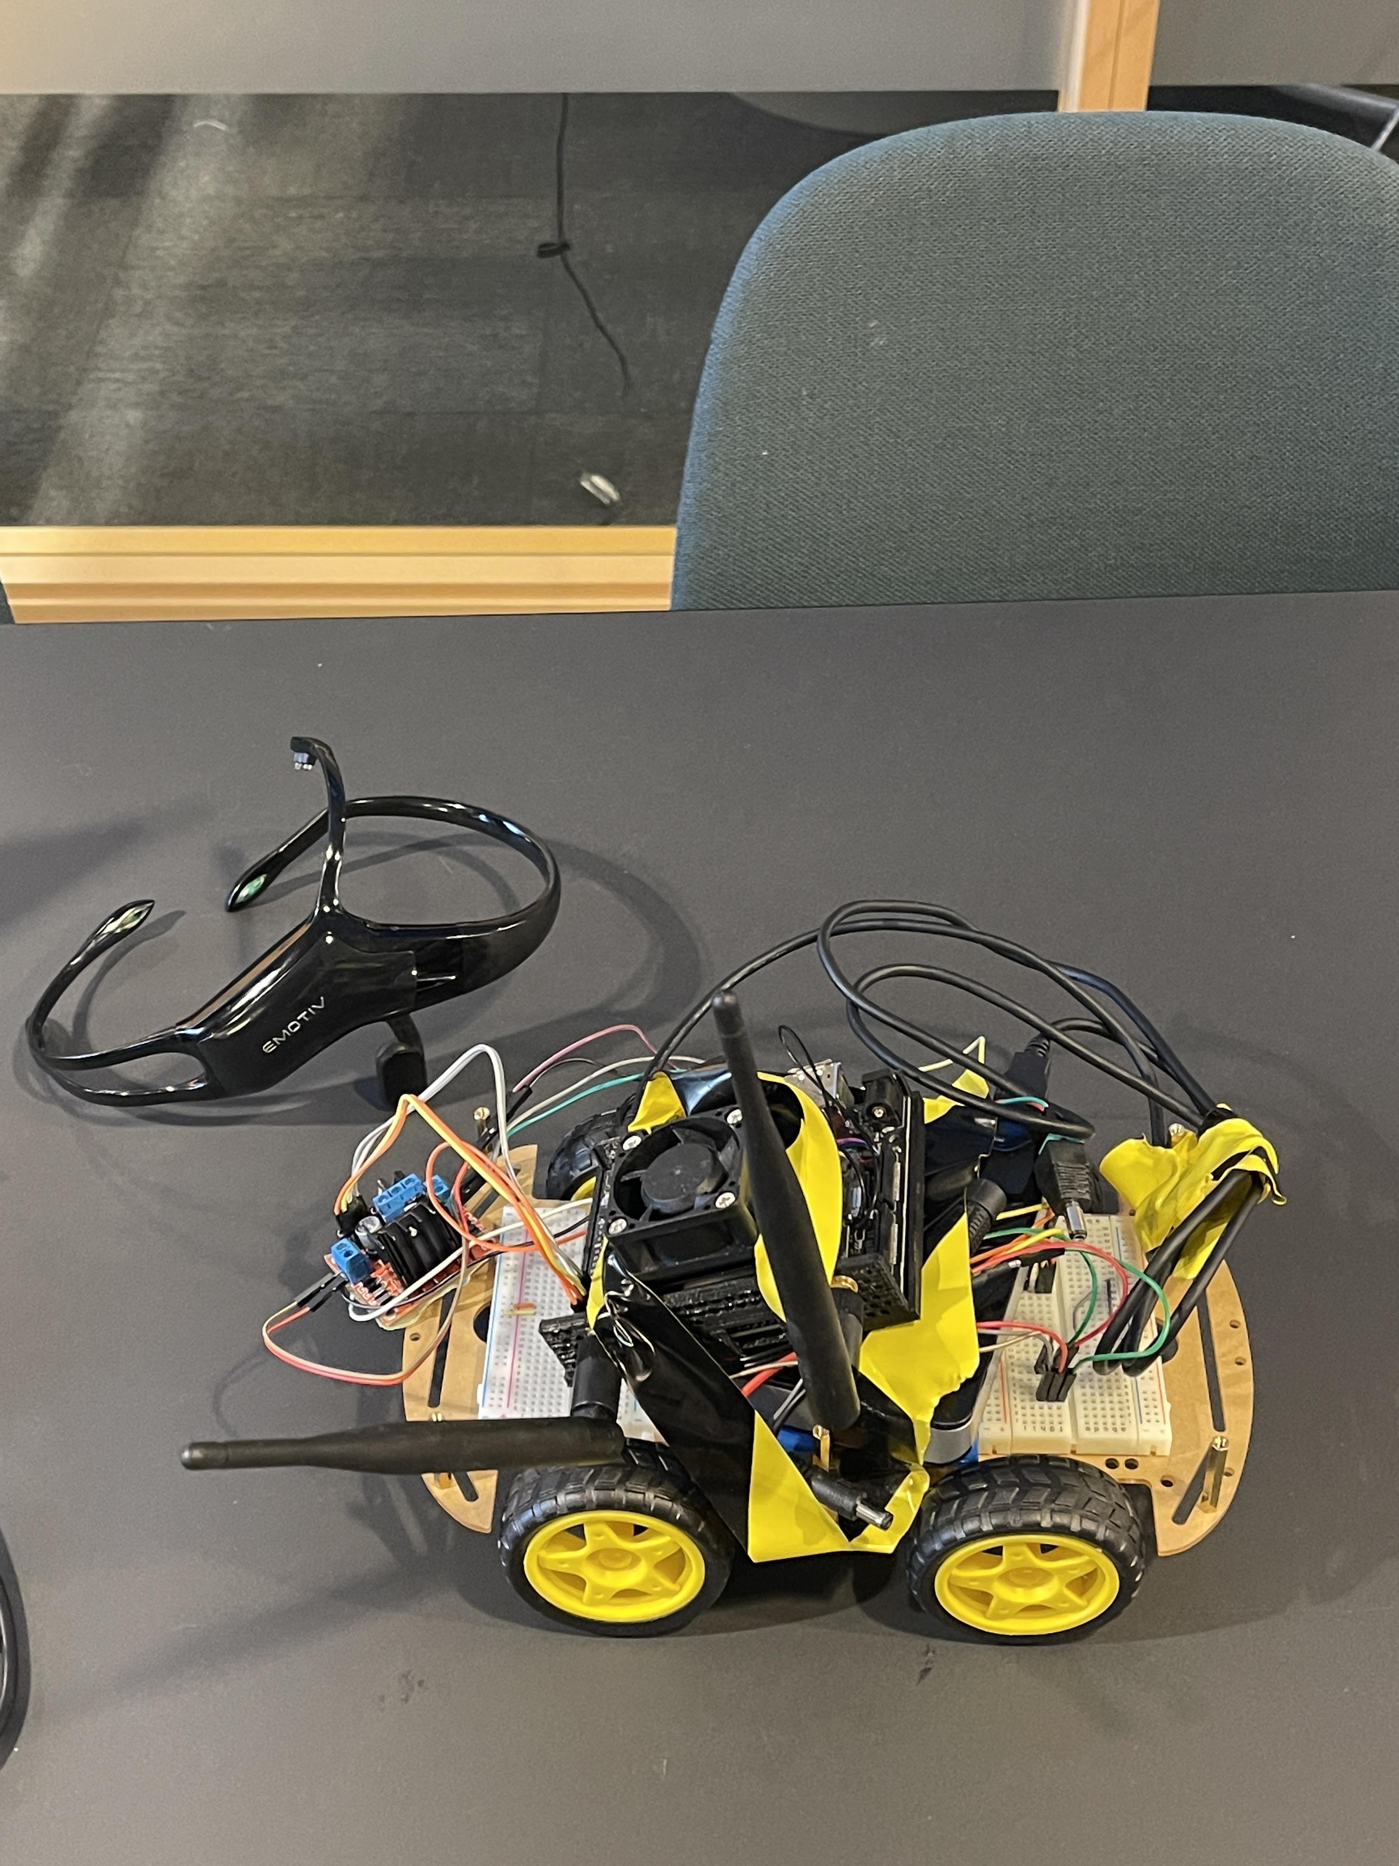
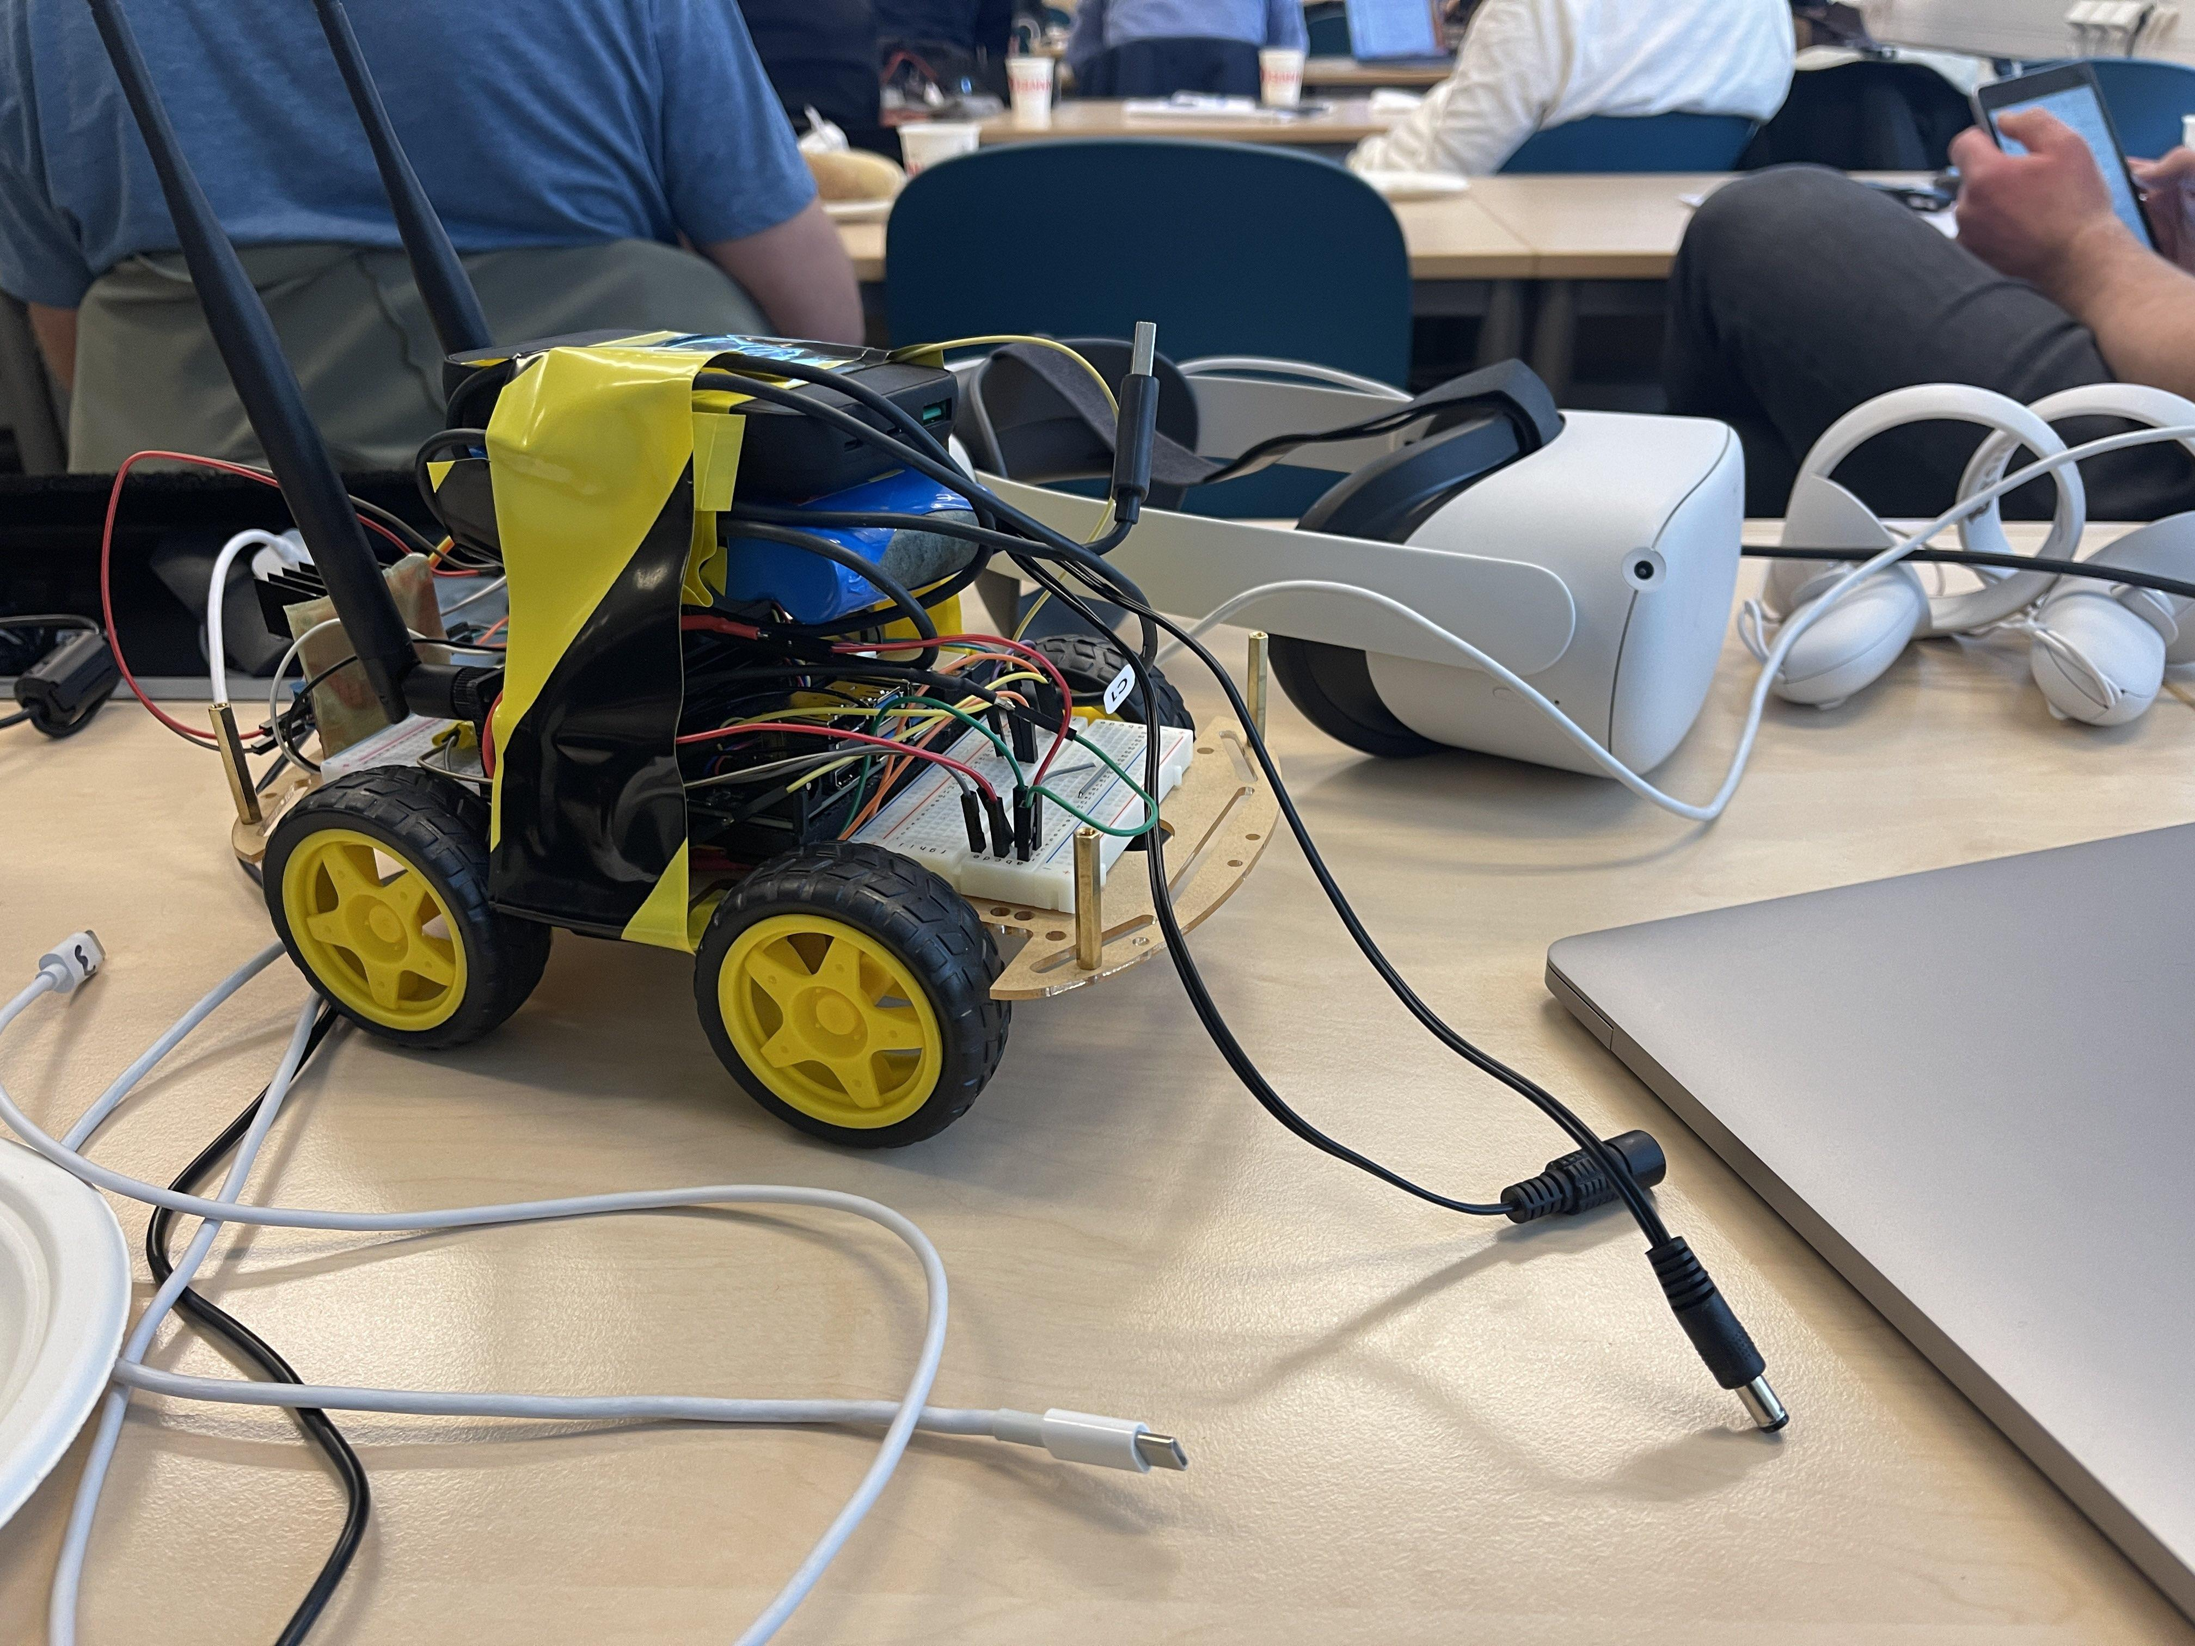

Slide 15
Virtual Reality and
Brain Computer Interface In Games
https://bci.games

